Slide 1
Digital Logic Design
Chapter 5
Combinational Logic with MSI and LSI

Slide 2
Introduction
As the technology of integrated circuits (IC) has improved, the number of gates that can be put on a single silicon chip has increased considerably.
The differentiation among the ICs in number of internal gates is made by a customary reference to a package as being a small-scale integration (SSI), medium-scale integration (MSI) or large-scale integration (LSI) device.
Several techniques can be designed and implemented by MSI and LSI circuits directly.
Decoders, multiplexers, read-only memories (ROM) and programmable logic arrays (PLA) are some techniques.

Slide 3
Binary Parallel Adder
Full-adder adds two bits with a previous carry.
Two binary numbers of n bits each can be added by means of this circuit.
4 3 2 1
C_{i} 0 1 1 0 z
A_{i} 1 0 1 1 x
B_{i} 0 0 1 1 y
Sum 1 1 1 0 S
C_{i+1} 0 0 1 1 C

Slide 4
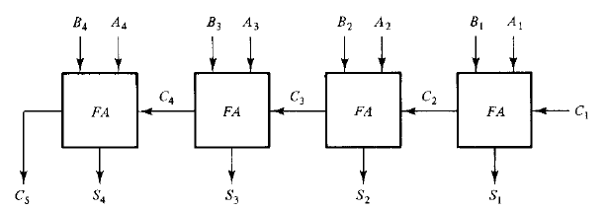
Binary Parallel Adder
A binary parallel adder is a digital function that produces the arithmetic sum of two binary numbers in parallel.
It consists of full-adders connected in cascade with the output carry from one full-adder connected to the input carry of the next full-adder.

Slide 5
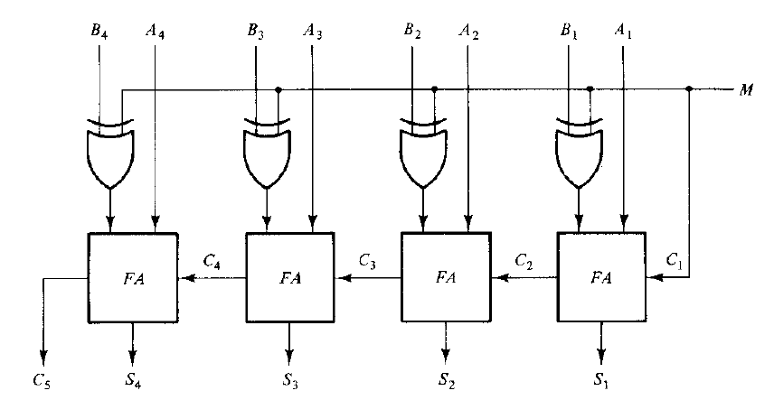
Binary Adder-Subtractor
By some modifications in the logic diagram of binary parallel adder we can achieve binary adder-subtractor.
We know that subtraction A – B can be done by taking the 2’s complement of B and adding it to A.

Slide 6
Carry Propagation
We have to remember that each circuit has a propagation delay.
In designing logic diagram, we have to take this delay into account because total propagation time is proportional to number of gate levels.
In binary parallel adder the number of gate levels increases with total bits in a number. Because addition of A₁ and B₁ depends on addition of A₀ and B₀ and …
We have to find out a way so that we can reduce the propagation time.

Slide 7
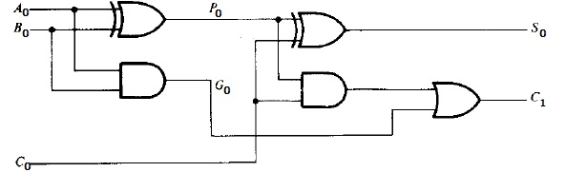
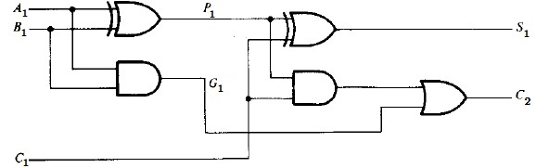
Carry Propagation

Slide 8

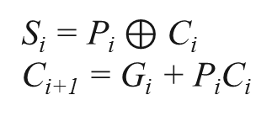
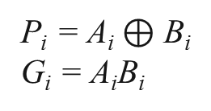
Carry Propagation
The most widely used technique employs the principle of look-ahead carry.
The output sum and carry can be expressed as
G_{i} is called a carry generate and P_{i} is called a carry propagate because it is the term associated with propagation of the carry from C_{i} to C_{i+1}.
P_{i} = A_{i} $⊕$ B_{i}
G_{i} = A_{i}B_{i}
S_{i} = P_{i} $⊕$ C_{i}
C_{i+1} = G_{i} + P_{i}C_{i}

Slide 9
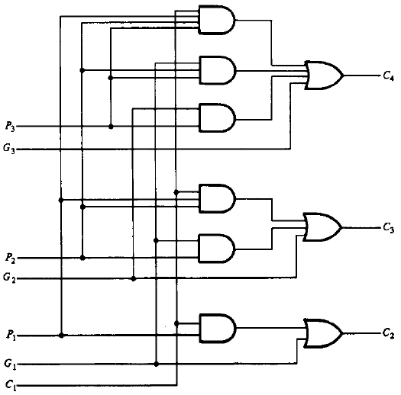
Carry Propagation

Slide 10
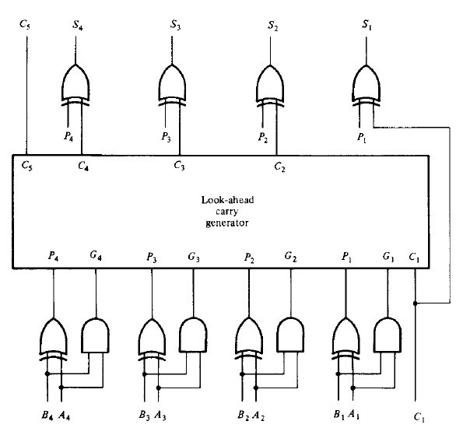
Carry Propagation

Slide 11
Decimal Adder
Computers or calculators perform arithmetic operations on decimal numbers.
These devices need to represent the decimal numbers in accepted code i.e. Binary Coded Decimal system.
For simplicity we are considering two numbers from 0 to 9 and an input carry together nine inputs as each number is represented in 4-bit binary code. Five outputs are generated – 4 bits for least significant digit and an output carry.
To understand this we need to learn about BCD adder.

Slide 12
BCD Adder
Since each input digit does not exceed 9, the output sum cannot be greater than 9 + 9 + 1 = 19.
The following table shows the conversion of decimal number to BCD.
The first column lists the binary sums as they appear in the outputs of a 4-bit binary adder. The second column represents the corresponding BCD.
The problem is to find a simple rule by which the binary number in the first column can be converted to the correct BCD-digit representation in the second column.

Slide 13
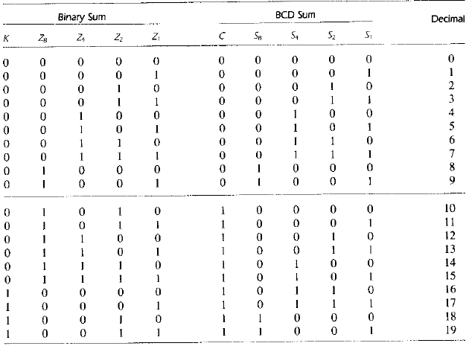
BCD Adder

Slide 14
BCD Adder
Now we need to find out the Boolean functions for C, S₈, S₄, S₂ and S₁.
S₈, S₄, S₂ and S₁ are identical to corresponding Z₈, Z₄, Z₂ and Z₁ when the binary sum is less than or equal to 1001.
When the binary sum is greater than 1001, the addition of 6(0110) to the binary sum converts it to the correct BCD representation.
First, we need to find out the Boolean function for C:
C = K + Z₈Z₄Z₂ + Z₈Z₄Z₂’ + Z₈Z₄’Z₂
= K + Z₈Z₄ + Z₈Z₄’Z₂
= K + Z₈(Z₄ + Z₄’Z₂)
= K + Z₈(Z₄ + Z₂) [ A + A’B = A + B ]
= K + Z₈Z₄ + Z₈Z₂
A + A’B
= A( B + 1) + A’B
= AB + A + A’B
= A + B

Slide 15
BCD Adder
When C = 1, it is necessary to add 6 (0110) to the binary sum and provide an output carry for the next stage.
To add 0110 to the binary sum, we use another 4-bit binary adder.
Two decimal digits, together with the input carry, are first added in the top 4-bit binary adder to produce the binary sum.

Slide 16
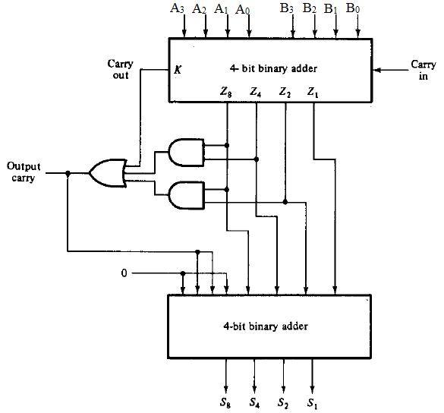

Slide 17
Magnitude Comparator
The comparison of two numbers is an operation that determines if one number is greater than, less than or equal to the other number.
Let us consider two numbers, A and B with four digits each.
A = A₃A₂A₁A₀
B = B₃B₂B₁B₀
Two numbers are equal if all pairs of significant digits are equal, i.e. A₃ = B₃ and A₂ = B₂ and A₁ = B₁ and A₀ = B₀.
The equity relation of two bits i.e. A_{i} and B_{i} can be expressed as: x_{i} = A_{i}B_{i} + A_{i}’B_{i}’ i = 0, 1, 2, 3
Here, x_{i} = 1 only if both are 1’s or both are 0’s.

Slide 18
Magnitude Comparator
For A = B, all pairs of digits of the two numbers are equal.
(A = B) = x₃x₂x₁x₀
To determine if A is greater than or less than B, we inspect the relative magnitudes of pairs of significant digits starting from the most significant position.
For A > B,
(A > B) = A₃B₃’ + x₃A₂B₂’ + x₃x₂A₁B₁’ + x₃x₂x₁A₀B₀’
For A < B,
(A < B) = A₃’B₃ + x₃A₂’B₂ + x₃x₂A₁’B₁ + x₃x₂x₁A₀’B₀

Slide 19
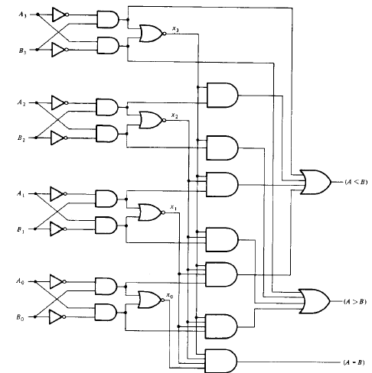

Slide 20
Decoders
A binary code of n bits is capable of representing up to 2^{n} distinct elements of the coded information.
A decoder is a combinational circuit that converts binary information from n input lines to a maximum of 2^{n} unique output lines.
The decoders are called n-to-m-line decoders, where m ≤ 2^{n}.
The circuit diagram of 3-to-8-line decoder is shown in the next slide.

Slide 21
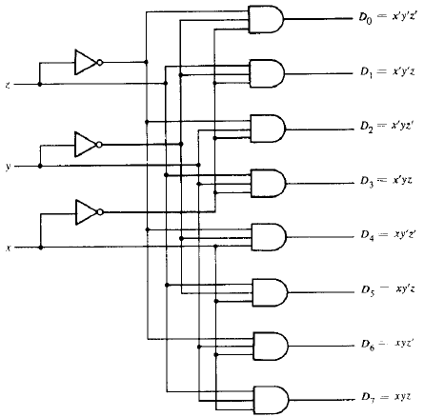
Decoders

Slide 22
Decoders
Inputs |  |  | Outputs
x | y | z | D₀ | D₁ | D₂ | D₃ | D₄ | D₅ | D₆ | D₇
0 | 0 | 0 | 1 | 0 | 0 | 0 | 0 | 0 | 0 | 0
0 | 0 | 1 | 0 | 1 | 0 | 0 | 0 | 0 | 0 | 0
0 | 1 | 0 | 0 | 0 | 1 | 0 | 0 | 0 | 0 | 0
0 | 1 | 1 | 0 | 0 | 0 | 1 | 0 | 0 | 0 | 0
1 | 0 | 0 | 0 | 0 | 0 | 0 | 1 | 0 | 0 | 0
1 | 0 | 1 | 0 | 0 | 0 | 0 | 0 | 1 | 0 | 0
1 | 1 | 0 | 0 | 0 | 0 | 0 | 0 | 0 | 1 | 0
1 | 1 | 1 | 0 | 0 | 0 | 0 | 0 | 0 | 0 | 1

Slide 23
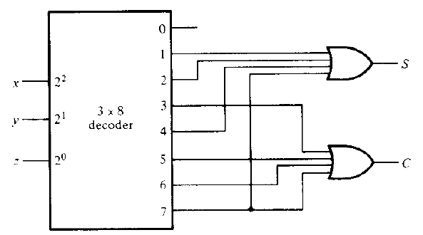
Combinational Logic Implementation
Implement a full-adder circuit with a decoder and OR gates.
We found the truth table of the functions for combinational circuit of Sum (S) and Carry (C) as:
S = Ʃ(1, 2, 4, 7) and C = Ʃ(3, 5, 6, 7)
The implementation with a 3-to-8 line decoder is shown as:

Slide 24
Combinational Logic Implementation
A function F having a list of k minterms can be expressed in its complemented form F’ with 2^{n} – F minterms.
In such case, it is advantageous to use a NOR gate to sum the minterms of F’.
For example, F(x, y, z) = Ʃ(0, 1, 2, 4, 5, 6)
F’ = Ʃ(3, 7)

Slide 25
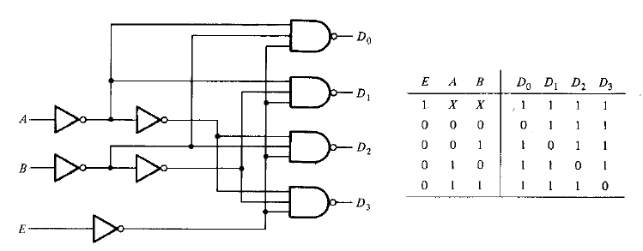
Demultiplexer
Most of the IC decoders include one or more enable inputs to control the circuit operation.
Usually the IC decoders are constructed with NAND gates.
The decoder outputs are in the complemented form.

Slide 26
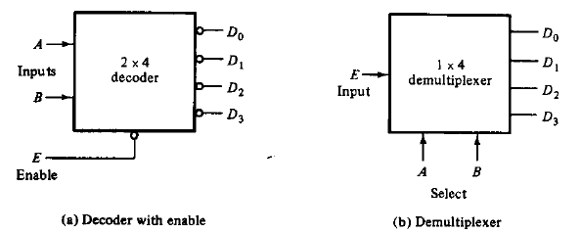
Demultiplexer
A demultiplexer is a circuit that receives information on a single line and transmits this information on one of the 2^{n} possible output lines.
n selection lines controls the selection of the output line.

Slide 27
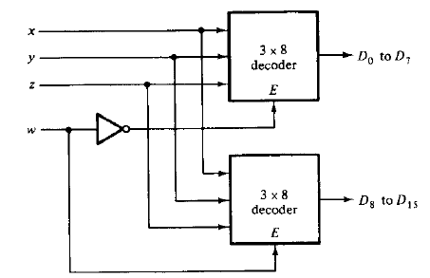
Demultiplexer
Decoder/demultiplexer circuits can be connected together to form a larger decoder circuit.
A 4x16 decoder is constructed from two 3x8 decoders as:

Slide 28
Encoder
An encoder performs the inverse operation of a decoder.
It has 2^{n} or (fewer) input lines and n output lines.
Inputs
D₀ | D₁ | D₂ | D₃ | D₄ | D₅ | D₆ | D₇
1 | 0 | 0 | 0 | 0 | 0 | 0 | 0
0 | 1 | 0 | 0 | 0 | 0 | 0 | 0
0 | 0 | 1 | 0 | 0 | 0 | 0 | 0
0 | 0 | 0 | 1 | 0 | 0 | 0 | 0
0 | 0 | 0 | 0 | 1 | 0 | 0 | 0
0 | 0 | 0 | 0 | 0 | 1 | 0 | 0
0 | 0 | 0 | 0 | 0 | 0 | 1 | 0
0 | 0 | 0 | 0 | 0 | 0 | 0 | 1
Outputs
x | y | z
0 | 0 | 0
0 | 0 | 1
0 | 1 | 0
0 | 1 | 1
1 | 0 | 0
1 | 0 | 1
1 | 1 | 0
1 | 1 | 1

Slide 29
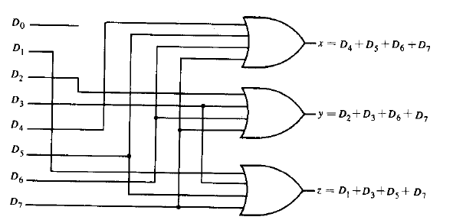
Encoder
The Boolean functions of x, y and z are:
z = D₁ + D₃ + D₅ + D₇
y = D₂ + D₃ + D₆ + D₇
z = D₄ + D₅ + D₆ + D₇

Slide 30
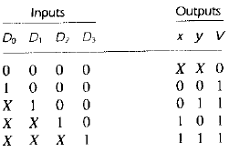
Priority Encoder
A priority encoder includes the priority function.
If two or more inputs are equal to 1 at the same time, the input having the highest priority will take precedence.
A valid-output indicator (V) is set to 1 when one or more of the inputs are equal to 1. If all are 0, then V is 0.

Slide 31
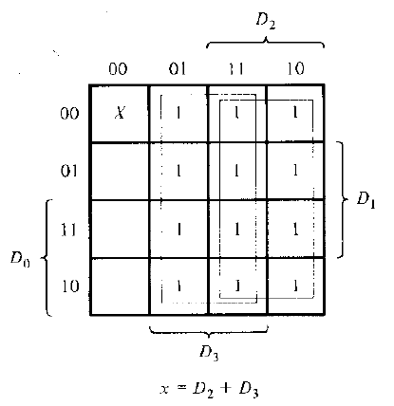
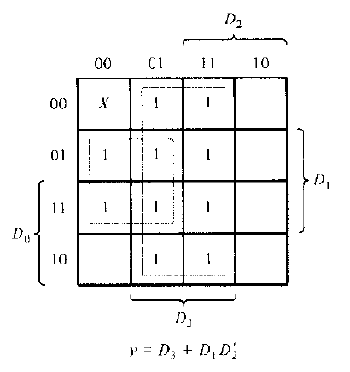
Priority Encoder
Although the table has 5 rows, we can obtain all 16 combinations replacing each don’t care condition first by 0 and then by 1.

